Slide 1
Supervisor Information
Using WebAdvisor to Approve Hours

Slide 2
Reasons for doing this:
Enhance Sustainability
Reduce delays in payroll processing
Improve accuracy – no handwriting
Ability to enter and approve hours on the web from anywhere at any time

Slide 3
WebAdvisor
Access from my.allegheny.edu
Sign in with Network User ID and password

Slide 4
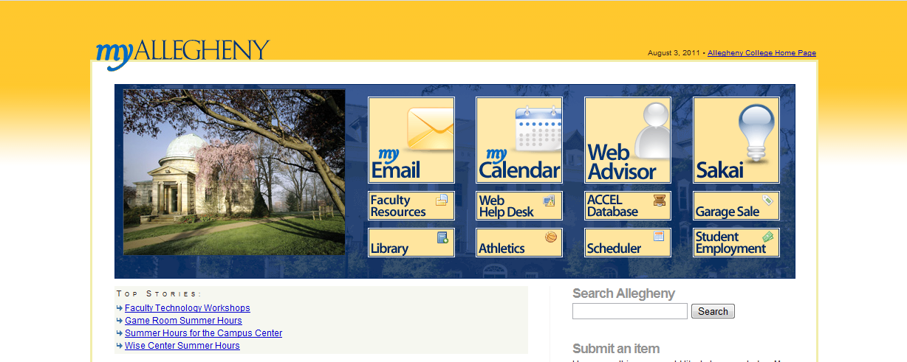

Slide 5
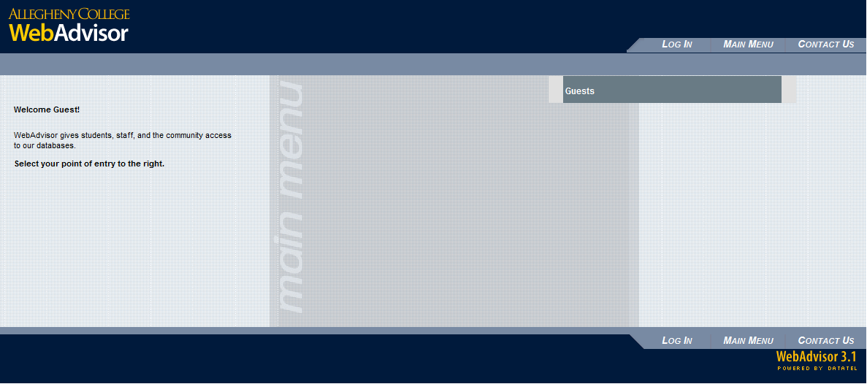

Slide 6
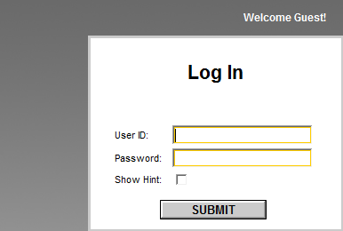
Enter your Network User ID and Password

Slide 7
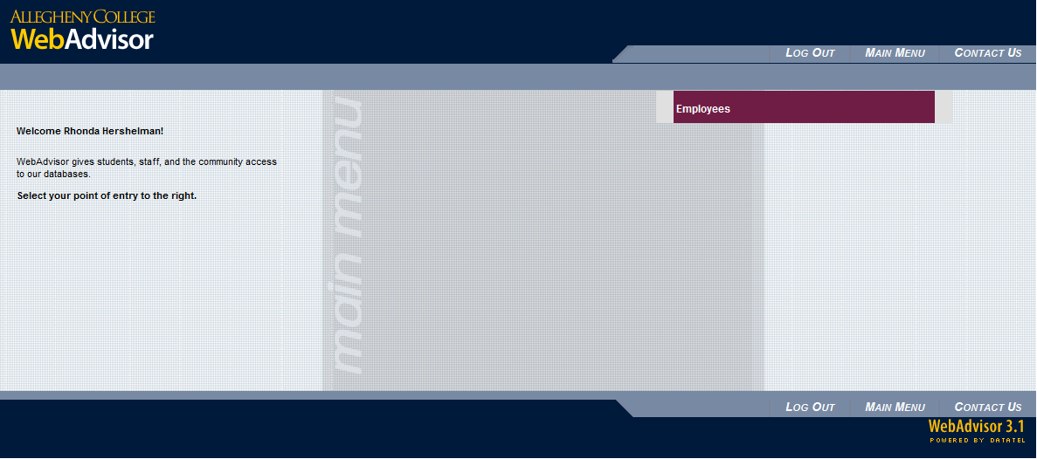
Select “Employees”

Slide 8
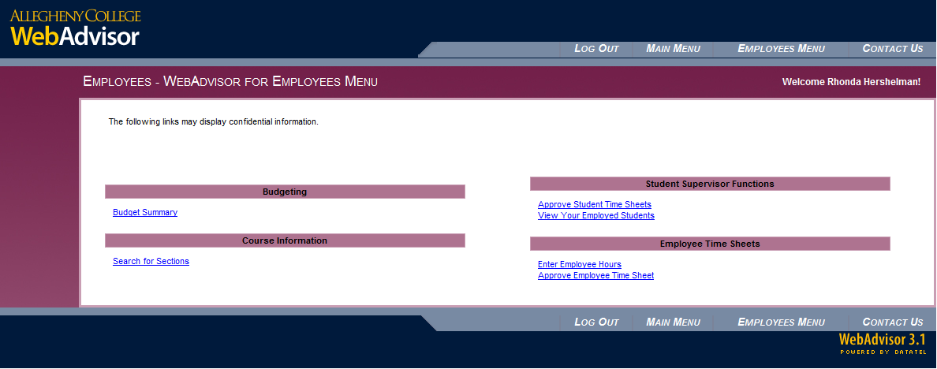
Select “Approve Employee Time Sheet”

Slide 9
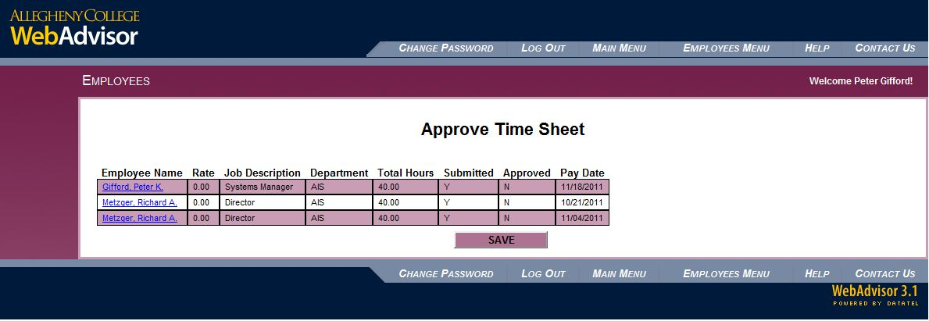
Select the Time Sheet to Approve

Slide 10
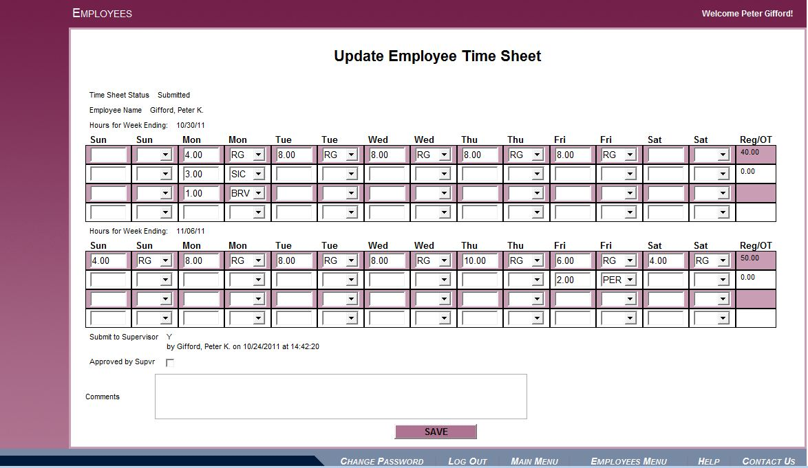
Verify the Information

Slide 11
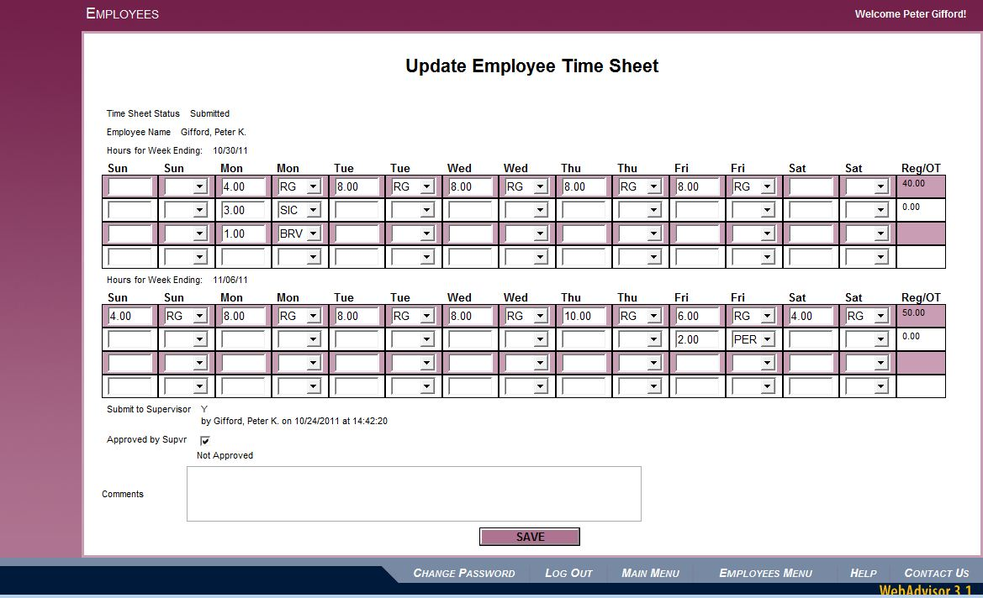
Check the Approved by Supvr box and click SAVE

Slide 12
Approving Time Sheets
Each Time Sheet will have 2 weeks on it. Be sure to check both weeks
Hours will be entered as regular unless another type (Sick, Vacation, etc) is needed.
Overtime will be determined by the system.

Slide 13
Entering Your Hours (2 of 6)
You may change hours if necessary. Please make a record in the comment box if you do.
Employees may view the final time sheet, including your comments, and they may add comments.
Once Approved neither you nor the employee may make changes.
Changes must be made by HR.

Slide 14
Entering Your Hours (4 of 6)
ALWAYS click the SAVE button to save your work. If you do not click SAVE, your approval will not be saved. You should click SAVE all the way back to the WebAdvisor Menu.

Slide 15
Entering Your Hours (6 of 6)
The Comments box will be visible to you, your Supervisor, and to HR so please use it as a communications tool. It is free form and can be as long as you need.
Your Supervisor can enter or respond to comments when approving your time sheet.

Slide 16
Next Steps
Start using WebAdvisor to approve time sheets
Continue to sign completed paper time sheets
HR will compare WebAdvisor with paper
Employees will be paid from paper time sheet

Slide 17
What to Expect
This is still a new system.
We have been testing for eight weeks but there may still be issues.

Slide 18
What to Do
If you have trouble logging in to WebAdvisor, call the Help Desk at 2755.
Report problems to Pete (2762) or Andy (4792) as soon as you find them.
Let us know if you have suggestions for improvement.

Slide 19
Questions

